Slide 1
BUSINESS ANALYTICS • RESEARCH PROJECT
DIGITAL
FRONTIER
Measuring Digital Development
Across Economies
158
ECONOMIES
ICT = Information and Communication Technology
ITU = International Telecommunication Union
IDI = ICT Development Index
A global snapshot of digital development
Nainadeep Kaur
BBA — Business Analytics (IBM) • Second Year

Slide 2
01 • THE QUESTION
02 / 12
Is digital development equally distributed?
WHY THIS MATTERS
How evenly is digital development distributed across economies — and how strongly is it associated with income level?
Digital participation shapes access to information, services, and opportunity.
WHAT WE COMPARE
Global score • six regions • four income groups • reported correlation.
HOW WE INTERPRET
THE CENTRAL INQUIRY
We identify patterns while acknowledging the limits of aggregate data.
A comparison of global, regional, and income-group patterns.
SOURCE: ITU ICT DEVELOPMENT INDEX 2026

Slide 3
02 • THE MEASURE
03 / 12
What does the IDI help us understand?
Digital development is more than a signal on a screen. It includes access to connectivity and the ability to use it meaningfully.
01
02
03
ACCESS
USE
MEANINGFUL CONNECTIVITY
Availability of digital infrastructure and services.
Internet use and participation in digital life.
The opportunity to benefit from being connected.
This presentation uses the IDI as an overall indicator; it does not reconstruct the official index formula or component weights.
SOURCE: ITU ICT DEVELOPMENT INDEX 2026

Slide 4
03 • METHOD
04 / 12
From source to evidence
01
02
03
04
05
SOURCE
→
SCOPE
→
GROUP
→
ANALYSE
→
INTERPRET
ITU ICT Development Index 2026
158 economies represented
Regional and income-group averages
Score differences and reported correlation
Patterns, meaning, and limitations
SCOPE NOTE
This deck uses supplied aggregate figures. No raw country-level dataset was provided for independent reconstruction.
SOURCE: ITU ICT DEVELOPMENT INDEX 2026

Slide 5
04 • GLOBAL SNAPSHOT
05 / 12
The global digital development snapshot
62.62
100.00
AVERAGE IDI SCORE
HIGHEST OBSERVED SCORE
158
37.38
ECONOMIES REPRESENTED
PROJECT-DEFINED GAP TO 100
100.00 − 62.62
A global average is a useful starting point, but it cannot show how scores are distributed across regions or income groups.
SOURCE: ITU ICT DEVELOPMENT INDEX 2026

Slide 6
05 • REGIONAL COMPARISON
06 / 12
A world of uneven digital development
AVERAGE IDI SCORE BY REGION
KEY FINDING
Europe
76.81
Europe leads at 76.81; Africa records the lowest average at 45.45.
Asia-Pacific
67.82
WHAT IT MEANS
CIS
65.75
The difference between these regional averages is 31.36 points.
Americas
57.45
Arab States
56.36
WHY IT MATTERS
One global average can conceal substantial regional differences.
Africa
45.45
SOURCE: ITU ICT DEVELOPMENT INDEX 2026

Slide 7
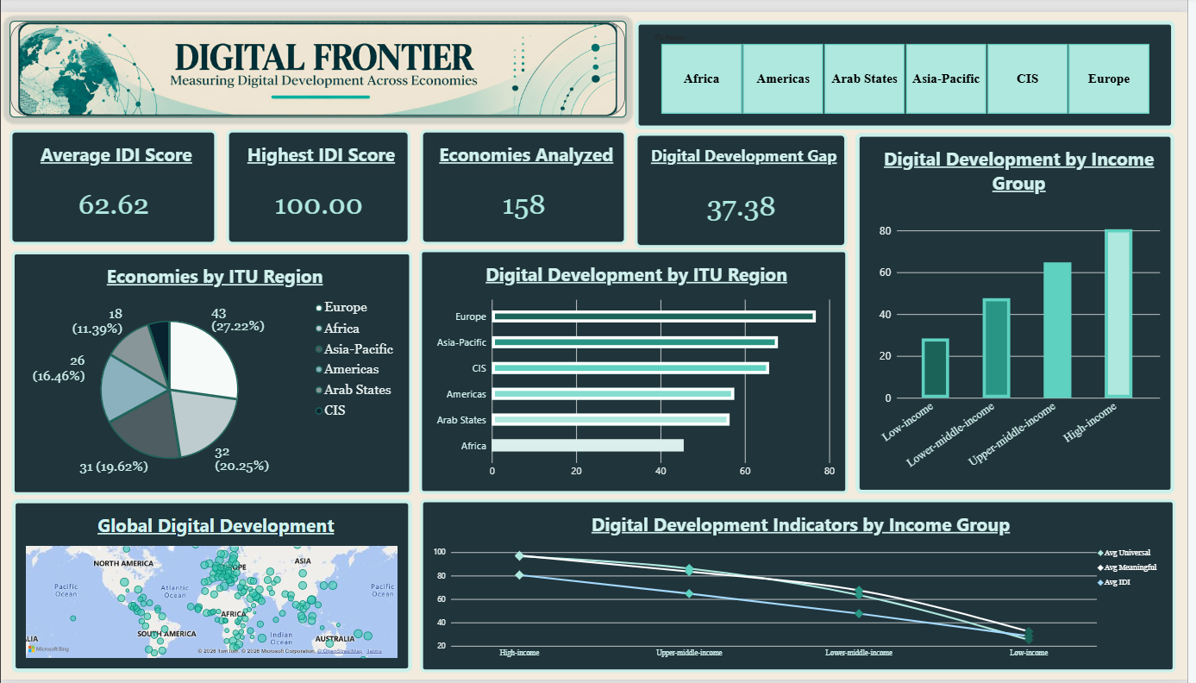
06 • POWER BI
07 / 12
Exploring the evidence through Power BI
POWER BI DASHBOARD

Slide 8
07 • INCOME AND IDI
08 / 12
Income and digital development move together
AVERAGE IDI SCORE BY INCOME GROUP
r ≈ 0.91
REPORTED PEARSON CORRELATION
80.55
64.66
47.60
Income level ↔ IDI score
Approximately 152 paired economies
28.38
INTERPRETATION
The reported results show a strong positive association.
High
income
Upper-
middle
Lower-
middle
Low
income
CAUTION
Correlation does not establish causation.
SOURCE: ITU ICT DEVELOPMENT INDEX 2026

Slide 9
08 • SAMPLE COMPOSITION
09 / 12
Where are the 158 economies distributed?
REGIONAL SAMPLE COMPOSITION
Europe
43
27.2%
Africa
32
20.3%
Asia-Pacific
31
19.6%
158
Americas
26
16.5%
ECONOMIES
Arab States
18
11.4%
CIS
8
5.1%
This describes sample composition, not regional digital performance. Regional score comparisons appear on Slide 6.
SOURCE: ITU ICT DEVELOPMENT INDEX 2026

Slide 10
09 • INTERPRETATION
10 / 12
Reading the patterns, not just the numbers
01
02
03
REGIONAL DISPARITY
INCOME-GROUP GAP
STRONG ASSOCIATION
Europe 76.81 • Africa 45.45
Difference: 31.36 points
High income 80.55 • Low income 28.38
Difference: 52.17 points
Reported Pearson r ≈ 0.91
~152 paired economies
Regional averages reveal gaps hidden by a single global figure.
The supplied group averages show a pronounced separation.
The variables are strongly associated; causation is not established.
SOURCE: ITU ICT DEVELOPMENT INDEX 2026

Slide 11
10 • RESPONSIBLE ANALYSIS
11 / 12
What this analysis can—and cannot—tell us
01
AGGREGATE AVERAGES
02
CORRELATION ≠ CAUSATION
Group averages conceal variation among individual economies.
The coefficient does not establish that income causes a particular IDI score.
03
PAIRED SAMPLE
04
NO HISTORICAL TREND
The correlation uses ~152 paired economies, versus 158 represented overall.
The supplied figures do not establish how scores changed over time.
05
RAW DATA NOT PROVIDED
Country-level records and calculations cannot be reconstructed from summary figures alone.
SOURCE: ITU ICT DEVELOPMENT INDEX 2026

Slide 12
THE TAKEAWAY
The digital
frontier is uneven.
“Measuring digital development is not just about comparing scores. It is about understanding where differences exist — and interpreting the evidence responsibly.”
Regional averages differ. Income-group averages diverge. The reported association is strong — but the evidence must be interpreted responsibly.
THANK YOU
01
Read global averages alongside regional differences.
02
Recognize the substantial income-group gap.
Source: ITU ICT Development Index 2026
itu.int/itu-d/reports/statistics/idi2026/
03
Treat association as evidence, not proof of causation.
DIGITAL FRONTIER • NAINADEEP KAUR

